Slide 1
UNIT 5
UNIT 5

Slide 2
Greedy Technique

Slide 3
IDEA
Computer scientists consider it a general design technique despite the fact that it is applicable to optimization problems only.
The greedy approach suggests constructing a solution through a sequence of steps, each expanding a partially constructed solution obtained so far, until a complete solution to the problem is reached.
On each step-and this is the central point of this technique-the choice made must be
feasible, i.e., it has to satisfy the problem's constraints
locally optimal, i.e., it has to be the best local choice among all feasible choices available on that step
irrevocable, i.e., once made, it cannot be changed on subsequent steps of the algorithm

Slide 4
IDEA
These requirements explain the technique's name: on each step, it suggests a "greedy" grab of the best alternative available in the hope that a sequence of locally optimal choices will yield a (globally) optimal solution to the entire problem.

Slide 5
SCENARIO 1
You have recently started playing a brand new computer game called "Mr. President". The game is about ruling a country, building infrastructures and developing it.
Your country consists of N cities and M bidirectional roads connecting them. Each road has assigned a cost of its maintenance. The greatest achievement in the game is called "Great Administrator" and it is given to a player who manages to have all cities in the country connected by roads in such a way that it is possible to travel between any two cities and that the sum of maintenance costs of these roads is the least.
How will you solve this problem?

Slide 6
SCENARIO 2
You are the owner of a company with branch offices in several cities; you want to lease phone lines to connect them up with each other; and the phone company charges different amounts of money to connect different pairs of cities. You want a set of lines that connects all your offices with a minimum total cost.
How will you solve this problem?

Slide 7
PROBLEM
Given n points, connect them in the cheapest possible way so that there will be a path between every pair of points.
We can represent the points by vertices of a graph, possible connections by the graph's edges, and the connection costs by the edge weights.
Then the question can be posed as the minimum spanning tree problem, defined formally as follows:

Slide 8
MINIMUM SPANNING TREE
A spanning tree of a connected graph is its connected acyclic subgraph (i.e., a tree) that contains all the vertices of the graph.
A minimum spanning tree of a weighted connected graph is its spanning tree of the smallest weight, where the weight of a tree is defined as the sum of the weights on all its edges.
The minimum spanning tree problem is the problem of finding a minimum spanning tree for a given weighted connected graph.

Slide 9
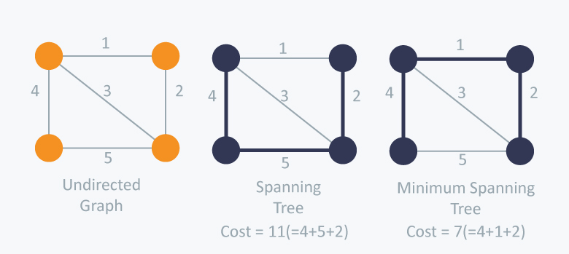
MINIMUM SPANNING TREE

Slide 10
PRIM’S ALGORITHM - IDEA
Prim's algorithm constructs a minimum spanning tree through a sequence of expanding subtrees.
The initial subtree in such a sequence consists of a single vertex selected arbitrarily from the set V of the graph's vertices.
On each iteration, we expand the current tree in the greedy manner by simply attaching to it the nearest vertex not in that tree.
(By the nearest vertex, we mean a vertex not in the tree connected to a vertex in the tree by an edge of the smallest weight. Ties can be broken arbitrarily.)

Slide 11
PRIM’S ALGORITHM - IDEA
The algorithm stops after all the graph's vertices have been included in the tree being constructed.
Since the algorithm expands a tree by exactly one vertex on each of its iterations, the total number of such iterations is n - 1, where n is the number of vertices in the graph.

Slide 12
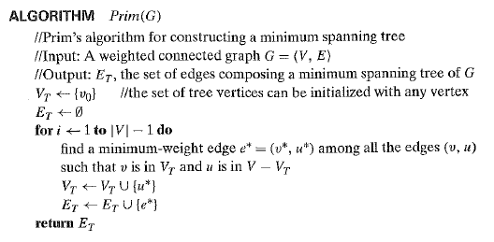
PRIM’S ALGORITHM

Slide 13
PRIM’S ALGORITHM - IDEA
The nature of Prim's algorithm makes it necessary to provide each vertex not in the current tree with the information about the shortest edge connecting the vertex to a tree vertex.
We can provide such information by attaching two labels to a vertex: the name of the nearest tree vertex and the length (the weight) of the corresponding edge.
Vertices that are not adjacent to any of the tree vertices can be given the label ∞ indicating their "infinite" distance to the tree vertices and a null label for the name of the nearest tree vertex.

Slide 14
PRIM’S ALGORITHM - IDEA
Alternatively, we can split the vertices that are not in the tree into two sets, the "fringe" and the "unseen."
The fringe contains only the vertices that are not in the tree but are adjacent to at least one tree vertex.
These are the candidates from which the next tree vertex is selected. The unseen vertices are all the other vertices of the graph, called "unseen" because they are yet to be affected by the algorithm.)
With such labels, finding the next vertex to be added to the current tree T = (V_{T}, E_{T}) becomes a simple task of finding a vertex with the smallest distance label in the set V- V_{T}.
Ties can be broken arbitrarily.

Slide 15
PRIM’S ALGORITHM - IDEA
After we have identified a vertex u* to be added to the tree, we need to perform two operations:
Move u* from the set V - V_{T} to the set of tree vertices V_{T}.
For each remaining vertex u in V - V_{T} that is connected to u* by a shorter edge than the u's current distance label, update its labels by u* and the weight of the edge between u* and u, respectively.

Slide 16
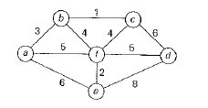
PRIM’S ALGORITHM - EXAMPLE

Slide 17
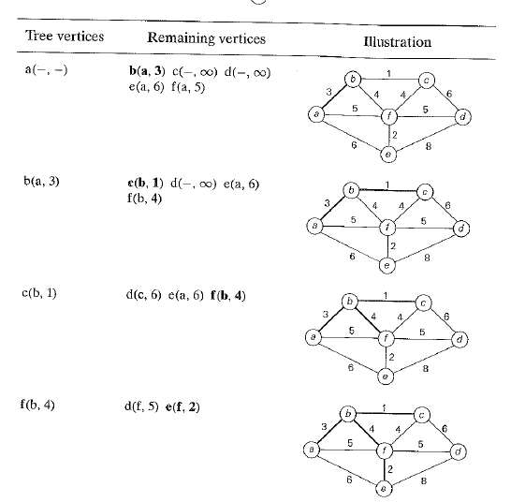
PRIM’S ALGORITHM - EXAMPLE

Slide 18
PRIM’S ALGORITHM - EXAMPLE

Slide 19
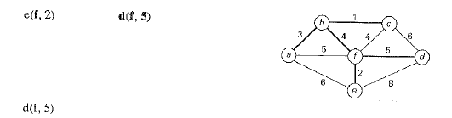
PRIM’S ALGORITHM - EXAMPLE

Slide 20
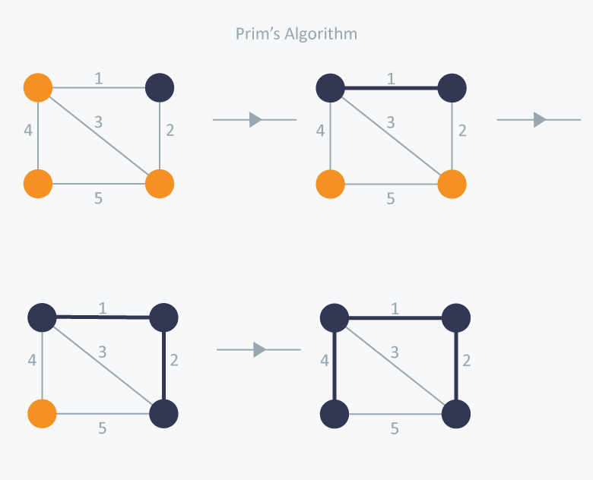
PRIM’S ALGORITHM - EXAMPLE

Slide 21
PRIM’S ALGORITHM – PROOF OF CORRECTNESS
Let us prove by induction that each of the subtrees T_{i}, i = 0, ... , n-1, generated by Prim's algorithm is a part (i.e., a subgraph) of some minimum spanning tree.
This immediately implies, of course, that the last tree in the sequence, T_{n-1}, is a minimum spanning tree itself because it contains all n vertices of the graph.
The basis of the induction is trivial, since T₀ consists of a single vertex and hence must be a part of any minimum spanning tree.
For the inductive step, let us assume that T_{i-1} is part of some minimum spanning tree T.
We need to prove that T_{i}, generated from T_{i-1} by Prim's algorithm, is also a part of a minimum spanning tree.

Slide 22
PRIM’S ALGORITHM – PROOF OF CORRECTNESS
We prove this by contradiction by assuming that no minimum spanning tree of the graph can contain T_{i}
Let e₁ = (v, u) be the minimum weight edge from a vertex in T_{i-1} to a vertex not in T_{i-1} used by Prim's algorithm to expand T_{i-1} toT_{i}.
By our assumption, e₁ cannot belong to the minimum spanning tree T. Therefore, if we add e₁ to T, a cycle must be formed.
In addition to edge e₁ = (v, u), this cycle must contain another edge (v', u') connecting a vertex v' belonging to T_{i-1} to a vertex u' that is not in T_{i-1}.
It is possible that v' coincides with v or u' coincides with u but not both.

Slide 23
PRIM’S ALGORITHM – PROOF OF CORRECTNESS
If we now delete the edge (v', u') from this cycle, we obtain another spanning tree of the entire graph whose weight is less than or equal to the weight of T since the weight of e1 is less than or equal to the weight of ( v', u').
Hence, this spanning tree is a minimum spanning tree, which contradicts the assumption that no minimum spanning tree contains T_{i}.

Slide 24
PRIM’S ALGORITHM – EFFICIENCY
If a graph is represented by its weight matrix and the priority queue is implemented as an unordered array, the algorithm's running time will be in Θ(|V|²).
If a graph is represented by its adjacency lists and the priority queue is implemented as a min-heap, the running time of the algorithm is in Θ(|E| log |V|).

Slide 25
KRUSKAL’S ALGORITHM - IDEA
The algorithm begins by sorting the graph's edges in non decreasing order of their weights.
Then, starting with the empty subgraph, it scans this sorted list adding the next edge on the list to the current sub graph if such an inclusion does not create a cycle and simply skipping the edge otherwise.

Slide 26
KRUSKAL’S ALGORITHM - IDEA
The algorithm begins by sorting the graph's edges in non decreasing order of their weights.
Then, starting with the empty subgraph, it scans this sorted list adding the next edge on the list to the current sub graph if such an inclusion does not create a cycle and simply skipping the edge otherwise.

Slide 27
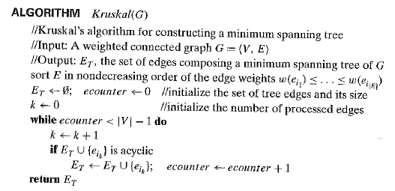
KRUSKAL’S ALGORITHM - IDEA

Slide 28
KRUSKAL’S ALGORITHM – PROOF OF CORRECTNESS
The correctness of Kruskal's algorithm can be proved by repeating the essential steps of the proof of Prim's algorithm given in the previous section.

Slide 29
KRUSKAL’S ALGORITHM – EXAMPLE

Slide 30
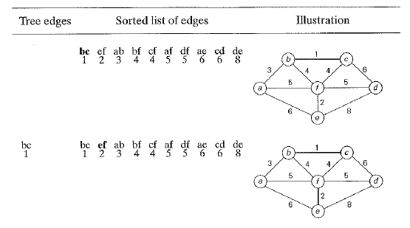
KRUSKAL’S ALGORITHM – EXAMPLE

Slide 31
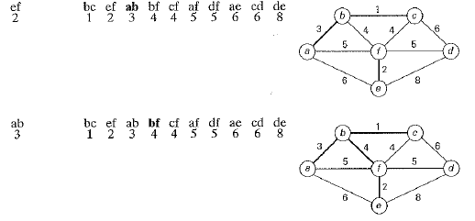
KRUSKAL’S ALGORITHM – EXAMPLE

Slide 32
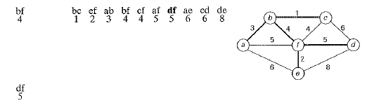
KRUSKAL’S ALGORITHM – EXAMPLE

Slide 33
KRUSKAL’S ALGORITHM
We can consider the algorithm's operations as a progression through a series of forests containing all the vertices of a given graph and some of its edges.
The initial forest consists of IV| trivial trees, each comprising a single vertex of the graph.
The final forest consists of a single tree, which is a minimum spanning tree of the graph.
On each iteration, the algorithm takes the next edge (u, v) from the sorted list of the graph's edges, finds the trees containing the vertices u and v, and, if these trees are not the same, unites them in a larger tree by adding the edge (u, v).
Fortunately, there are efficient algorithms for doing so, including the crucial check whether two vertices belong to the same tree. They are called union-find algorithms.

Slide 34
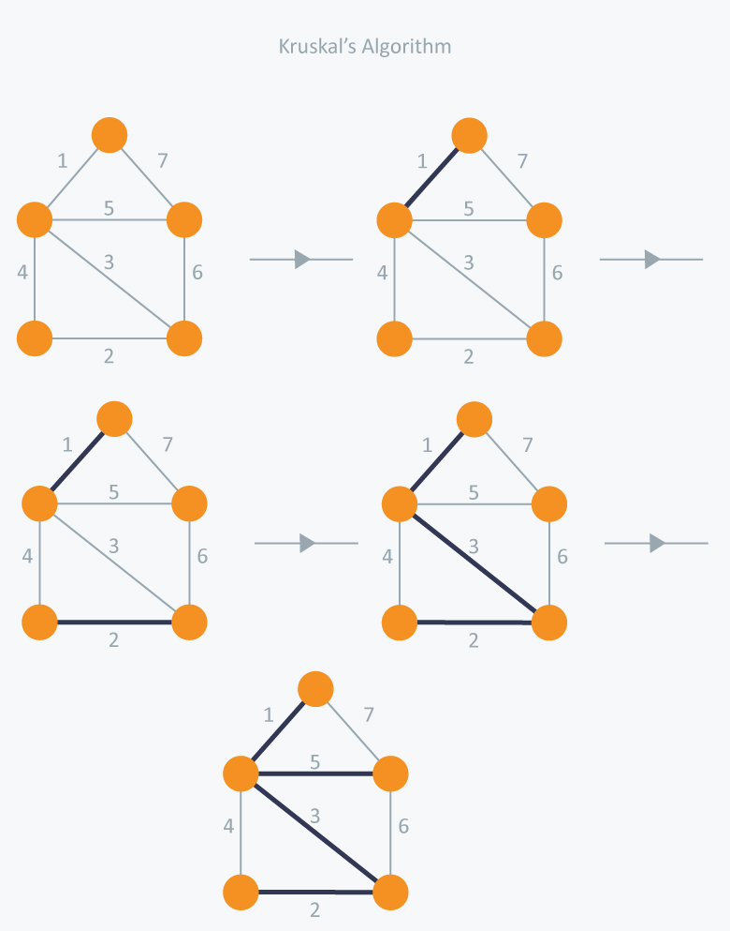
KRUSKAL’S ALGORITHM – EXAMPLE

Slide 35
DIJKSTRA’S ALGORITHM
Solves the single-source shortest-paths problem.
For a given vertex called the source in a weighted connected graph, find shortest paths to all its other vertices.
This algorithm is applicable to graphs with non negative weights only.

Slide 36
DIJKSTRA’S ALGORITHM – IDEA
Dijkstra's algorithm finds the shortest paths to a graph's vertices in order of their distance from a given source.
First, it finds the shortest path from the source to a vertex nearest to it, then to a second nearest, and so on.
In general, before its i^{th} iteration commences, the algorithm has already identified the shortest paths to i - 1 other vertices nearest to the source.
These vertices, the source, and the edges of the shortest paths leading to them from the source form a subtree T_{i}, of the given graph.

Slide 37
DIJKSTRA’S ALGORITHM – IDEA
The next vertex nearest to the source can be found among the vertices adjacent to the vertices of T_{i}.
The set of vertices adjacent to the vertices in T_{i} can be referred to as "fringe vertices"; they are the candidates from which Dijkstra's algorithm selects the next vertex nearest to the source.
To identify the i^{th} nearest vertex, the algorithm computes, for every fringe vertex u, the sum of the distance to the nearest tree vertex v (given by the weight of the edge (v, u)) and the length d_{v}, of the shortest path from the source to v (previously determined by the algorithm) and then selects the vertex with the smallest such sum.
The fact that it suffices to compare the lengths of such special paths is the central insight of Dijkstra's algorithm.

Slide 38
DIJKSTRA’S ALGORITHM – IDEA
To facilitate the algorithm's operations, we label each vertex with two labels.
The numeric label d indicates the length of the shortest path from the source to this vertex found by the algorithm so far; when a vertex is added to the tree, d indicates the length of the shortest path from the source to that vertex.
The other label indicates the name of the next-to-last vertex on such a path, i.e., the parent of the vertex in the tree being constructed.

Slide 39
DIJKSTRA’S ALGORITHM – IDEA
With such labeling, finding the next nearest vertex u* becomes a simple task of finding a fringe vertex with the smallest d value. Ties can be broken arbitrarily.
After we have identified a vertex u* to be added to the tree, we need to perform two operations:
Move u* from the fringe to the set of tree vertices.
For each remaining fringe vertex u that is connected to u* by an edge of weight w(u*, u) such that d.,.+ w(u*, u) <d.,, update the labels of u by u* and du* + w(u*, u), respectively.

Slide 40
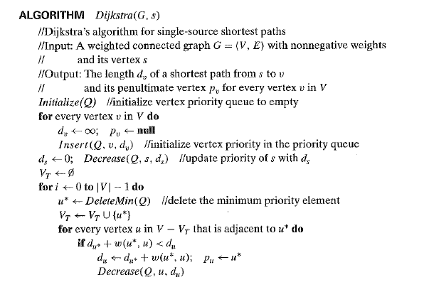
DIJKSTRA’S ALGORITHM

Slide 41
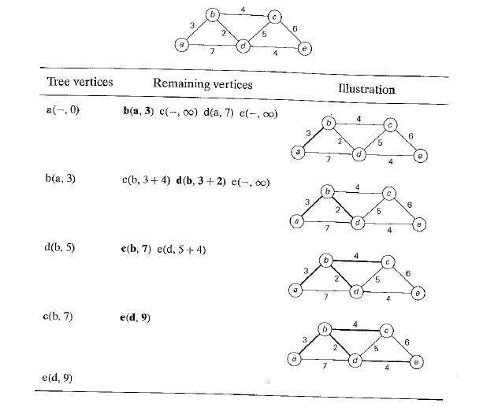
DIJKSTRA’S ALGORITHM - EXAMPLE

Slide 42
DIJKSTRA’S ALGORITHM - EXAMPLE

Slide 43
DIJKSTRA’S ALGORITHM – EFFICIENCY
If a graph is represented by its weight matrix and the priority queue is implemented as an unordered array, the algorithm's running time will be in Θ(|V|²).
If a graph is represented by its adjacency lists and the priority queue is implemented as a min-heap, the running time of the algorithm is in Θ(|E| log |V|).

Slide 44
PROBLEM
Encode a text that comprises characters from some n-character alphabet by assigning to each of the text's characters some sequence of bits called the codeword.

Slide 45
SOLUTION
Fixed-length Encoding
Assigns to each character a bit string of the same length m
(m <= log2 n ). This is exactly what the standard ASCII code does.
Problem: Consumes more space
Variable-length Encoding
Assigns codewords of different lengths to different characters.

Slide 46
PROBLEM WITH VARIABLE LENGTH ENCODING
Suppose Variable – Length Encoding assigns the following codes:
A – 0, B – 1, C – 01, D – 00, E – 001
So if the encoded string is 00101, is the actual string EC or AABC or DBC or … ?

Slide 47
PROBLEM WITH VARIABLE LENGTH ENCODING
To avoid this complication, prefix-free (or simply prefix) codes are used.
In a prefix code, no codeword is a prefix of a codeword of another character.
Hence, with such an encoding, we can simply scan a bit string until we get the first group of bits that is a codeword for some character, replace these bits by this character, and repeat this operation until the bit string's end is reached.

Slide 48
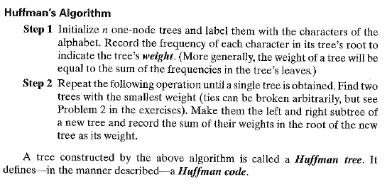
HUFFMAN’S ALGORITHM

Slide 49

EXAMPLE
Consider the five-character alphabet {A, B, C, D, _} with the following occurrence probabilities:

Slide 50
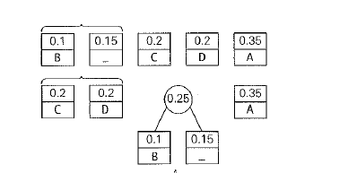
EXAMPLE

Slide 51
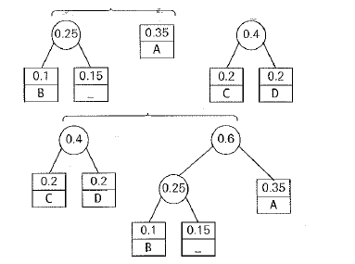
EXAMPLE

Slide 52
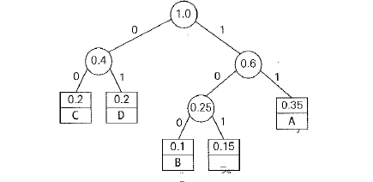
EXAMPLE

Slide 53

EXAMPLE

Slide 54
EXAMPLE
With the occurrence probabilities given and the codeword lengths obtained, the expected number of bits per character in this code is
2. 0.35 + 3. 0.1 + 2. 0.2 + 2. 0.2 + 3. 0.15 = 2.25.
Had we used a fixed-length encoding for the same alphabet, we would have to use at least three bits per each character.
Thus, for this toy example, Huffman's code achieves the compression ratio – a standard measure of a compression algorithm's effectiveness-of (3- 2.25)/3 · 100% = 25%.

Slide 55
APPLICATIONS
File Compression (ZIP, WINZIP, JPEG, PNG, etc.)
Construction of a binary tree with minimum weighted path length

